Slide 1
Lecture 3 Singular Value Decomposition
NLA Chapter 4 & 5

Slide 2
What, why, and how?
What: Singular Value Decomposition (SVD) is a matrix factorization that make every matrix like a diagonal matrix.
Why:
Conceptual: a powerful device to link many concepts together: rank, 2-norm, F-norm, trace, … In general, a great device for proving and understanding! (When facing a problem, ask yourself “what if I take an SVD of the matrix?)
Practical: SVD leads to the most accurate algorithm for solving linear system/least square problem; optimal low-rank matrix approximation; computing the 2-norm; …
How: have to defer the computation of SVD to later lectures on eigenvalues (QR algorithms) and iterative methods (Lanczos/Arnoldi iteration).
QR algorithm is probably the pinnacle of (classic) NLA! Very reliable, fast, and beautiful algorithm to compute eigen/singular value/vectors.

Slide 3

SVD– The Swiss Army Knife…
Source: https://www.amazon.com/dp/B001DZTJRQ

Slide 4
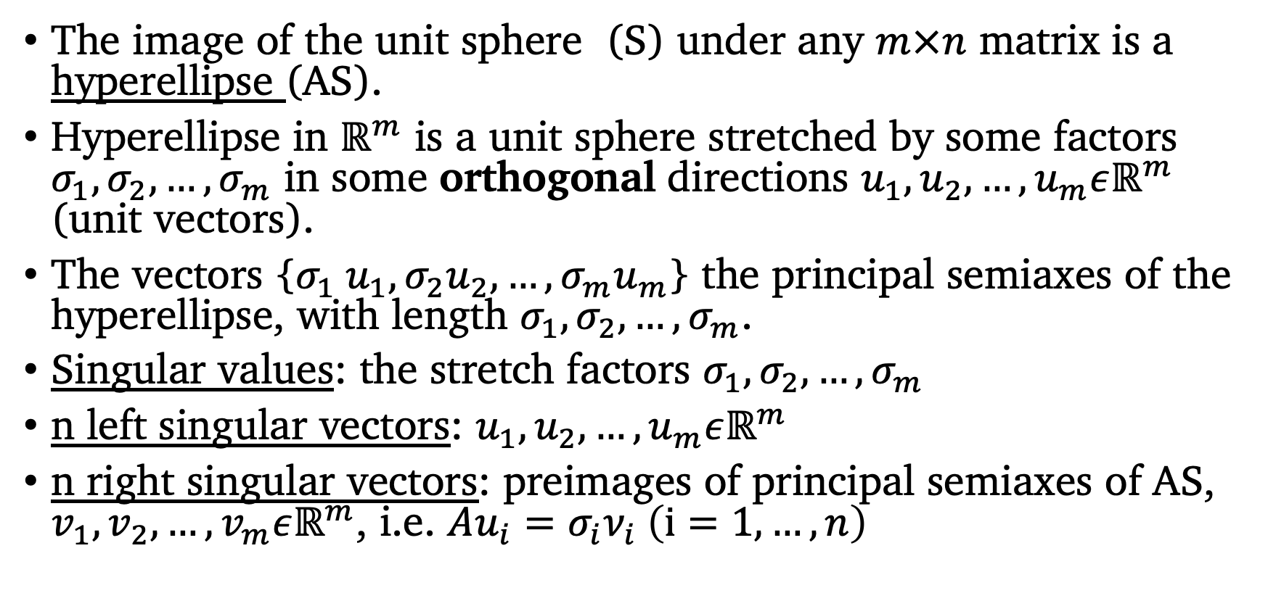
Geometric Intuition
The image of the unit sphere (S) under any $m×n$ matrix is a hyperellipse (AS).
Hyperellipse in $ℝ^{m}$ is a unit sphere stretched by some factors $σ_{1},σ_{2},…,σ_{m}$ in some orthogonal directions $u_{1},u_{2},…,u_{m}εℝ^{m}$ (unit vectors).
The vectors {$σ_{1} u_{1},{σ_{2}u}_{2},…,{σ_{m}u}_{m}$} the principal semiaxes of the hyperellipse, with length $σ_{1},σ_{2},…,σ_{m}$.
Singular values: the stretch factors $σ_{1},σ_{2},…,σ_{m}$
n left singular vectors: $u_{1},u_{2},…,u_{m}εℝ^{m}$
n right singular vectors: preimages of principal semiaxes of AS, $v_{1},v_{2},…,v_{m}εℝ^{m}$, i.e. $Au_{i}=σ_{i}ν_{i} \left(ⅈ=1,…,n\right)$

Slide 5
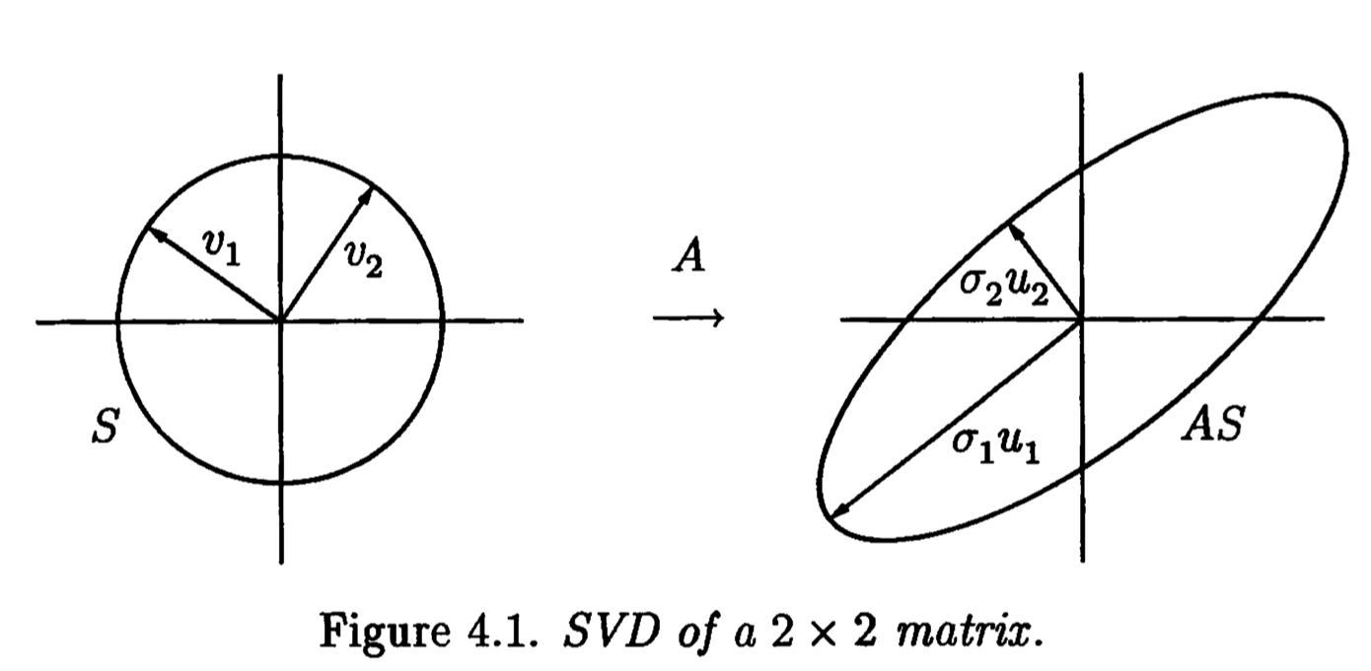
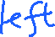
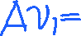
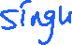
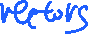
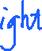
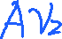
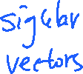

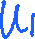
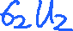

Slide 6
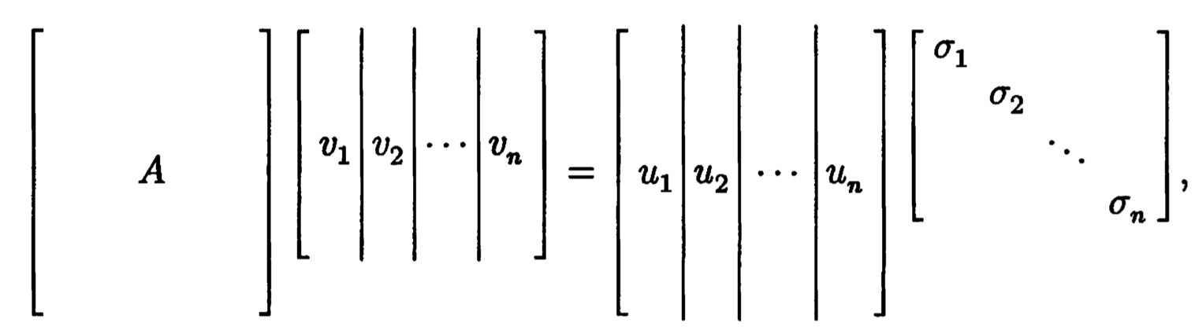
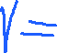
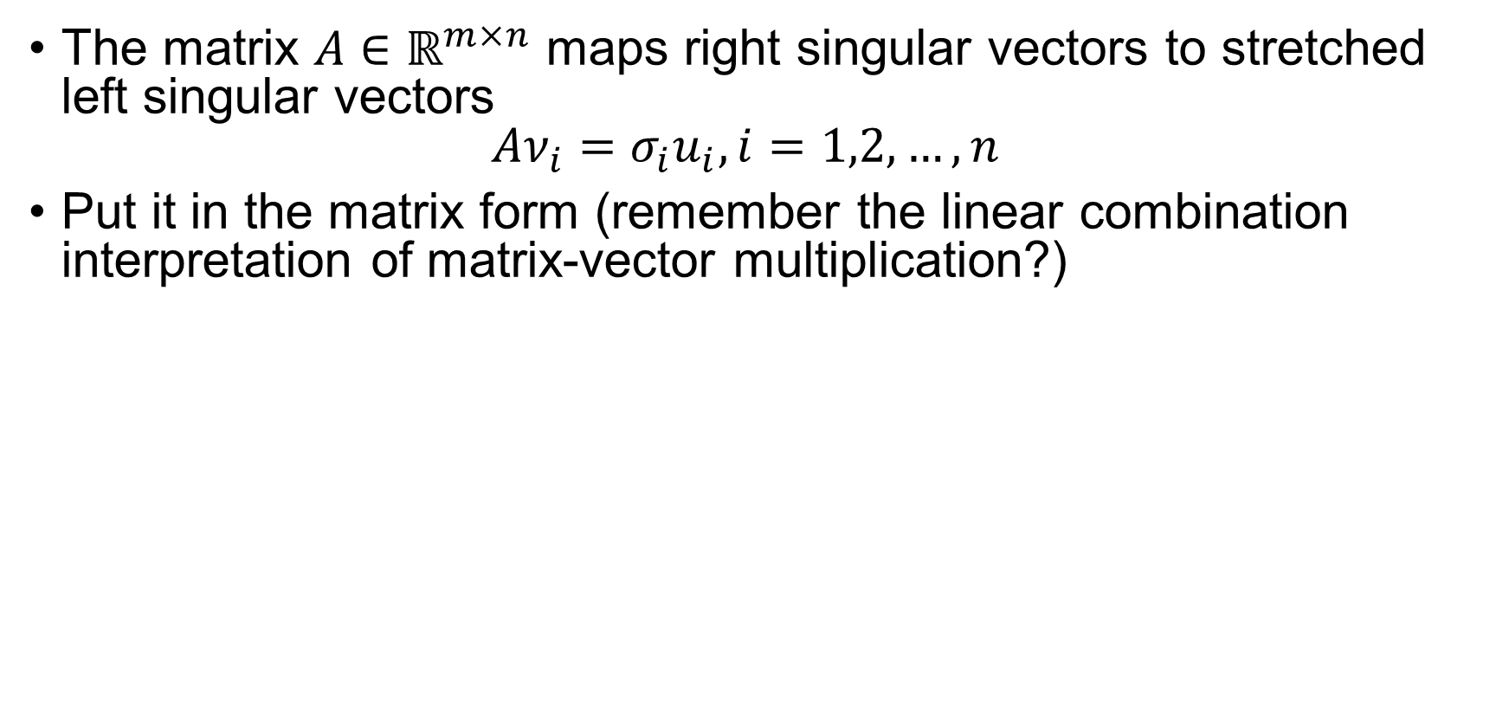

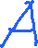
Reduced SVD (1)
The matrix $A∈ℝ^{m×n}$ maps right singular vectors to stretched left singular vectors $Aν_{i}=σ_{i}u_{i}, i=1,2,…,n$
Put it in the matrix form (remember the linear combination interpretation of matrix-vector multiplication?)

Slide 7
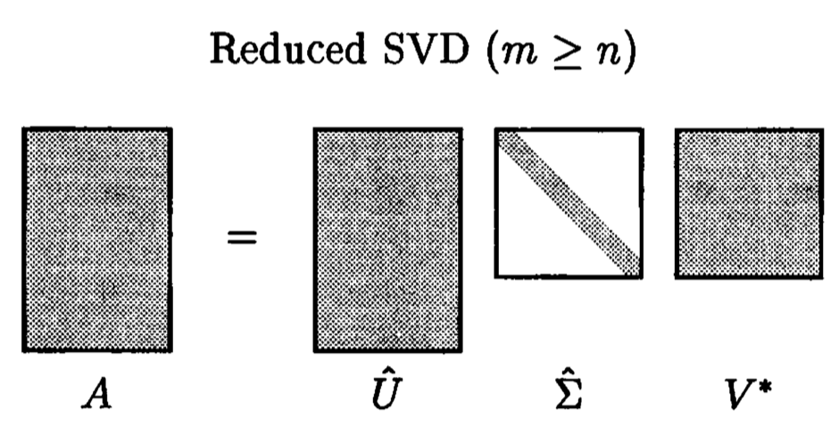
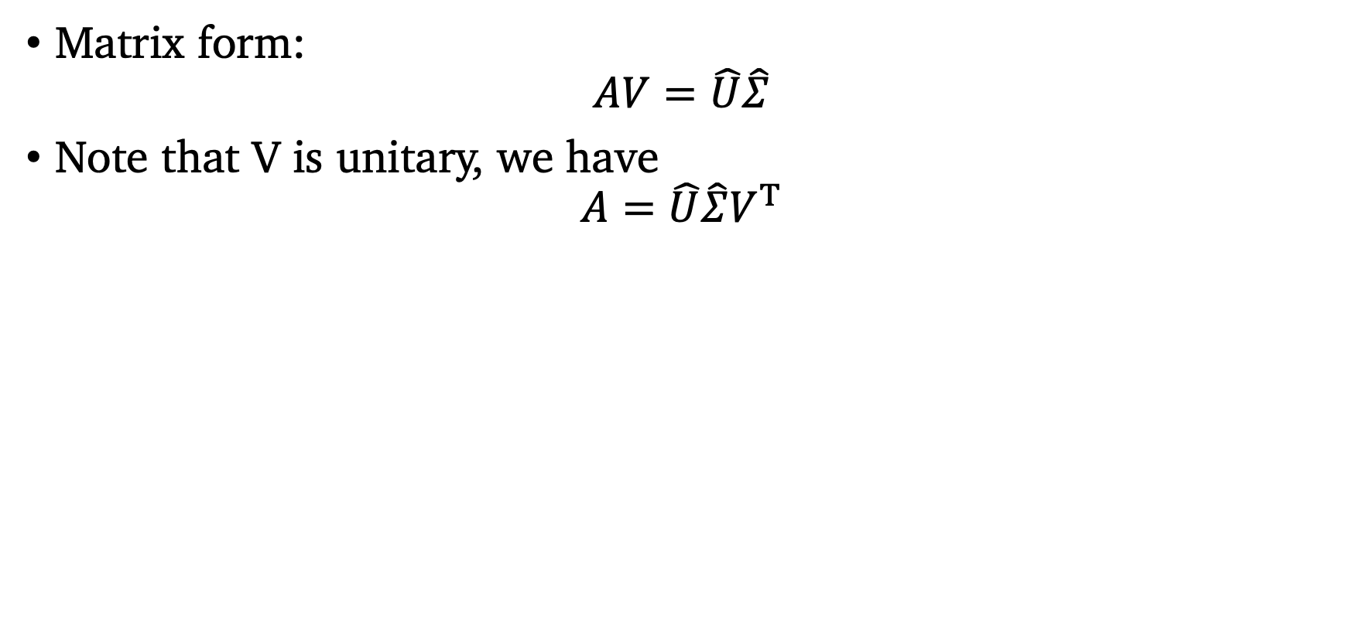
Reduced SVD (2)
Matrix form: $AV=\hat{U}\hat{Σ}$
Note that V is unitary, we have $A=\hat{U}\hat{Σ}V^{T}$

Slide 8
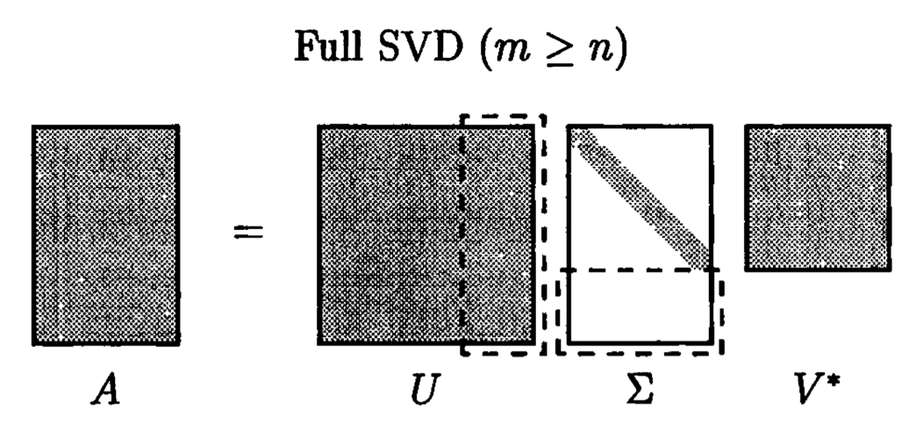
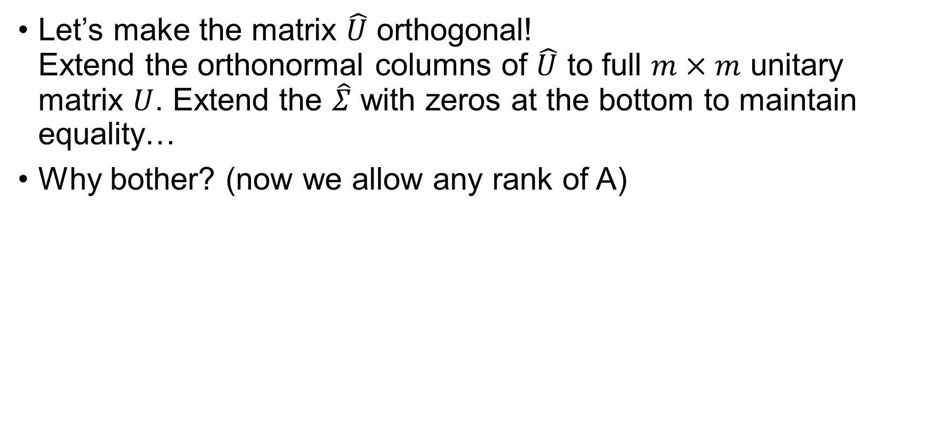
Full SVD
Let’s make the matrix $\hat{U}$ orthogonal! Extend the orthonormal columns of $\hat{U}$ to full $m×m$ unitary matrix $U$. Extend the $\hat{Σ}$ with zeros at the bottom to maintain equality…
Why bother? (now we allow any rank of A)

Slide 9
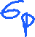

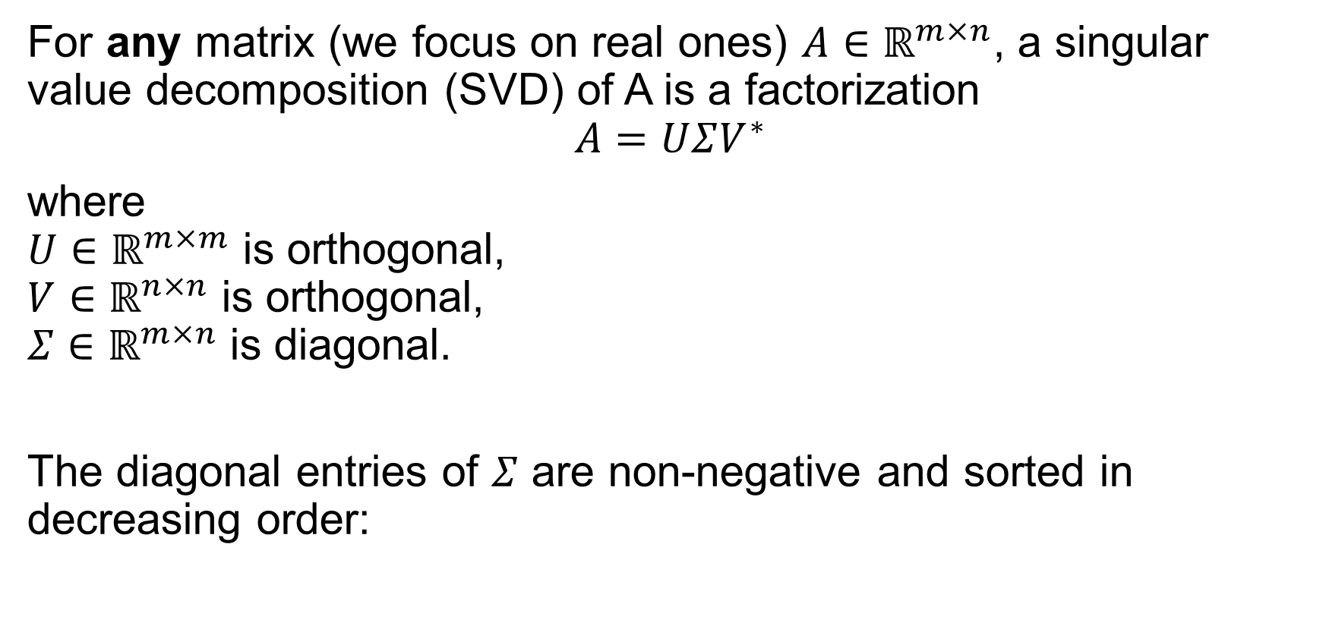
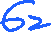
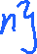
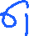
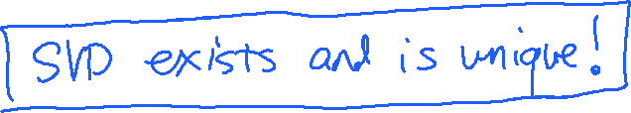
Formal definition of SVD
For any matrix (we focus on real ones) $A∈ℝ^{m×n}$, a singular value decomposition (SVD) of A is a factorization $$A=UΣV^{∗}$$
where $U∈ℝ^{m×m}$ is orthogonal, $V∈ℝ^{n×n}$ is orthogonal, $Σ∈ℝ^{m×n}$ is diagonal.
The diagonal entries of $Σ$ are non-negative and sorted in decreasing order:

Slide 10
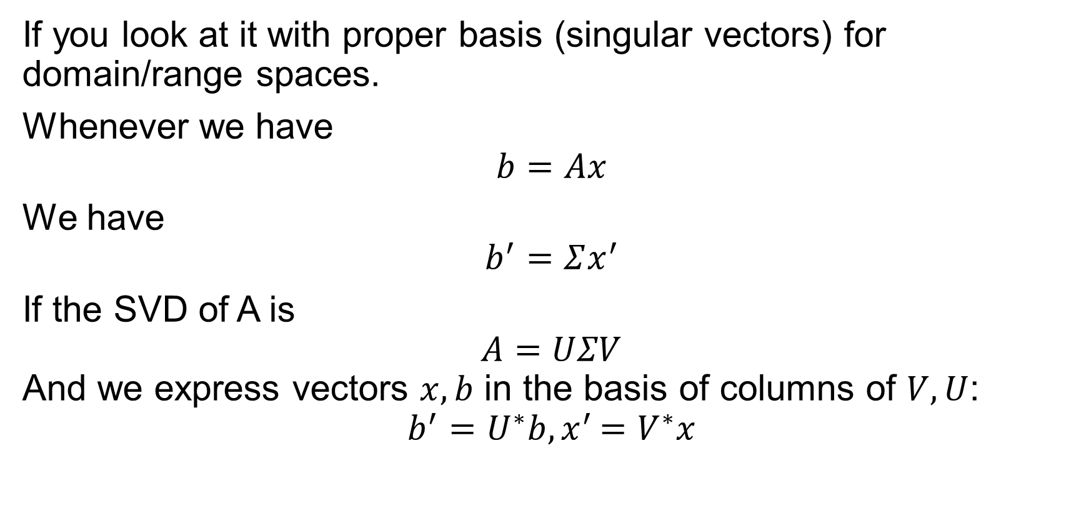
SVD: every matrix is diagonal…
If you look at it with proper basis (singular vectors) for domain/range spaces.
Whenever we have $$b=Ax$$
We have $$b^{′}=Σx^{′}$$
If the SVD of A is $$A=UΣV$$ And we express vectors $x,b$ in the basis of columns of $V,U$: $$b^{′}=U^{∗}b{, x}^{′}=V^{∗}x$$

Slide 11
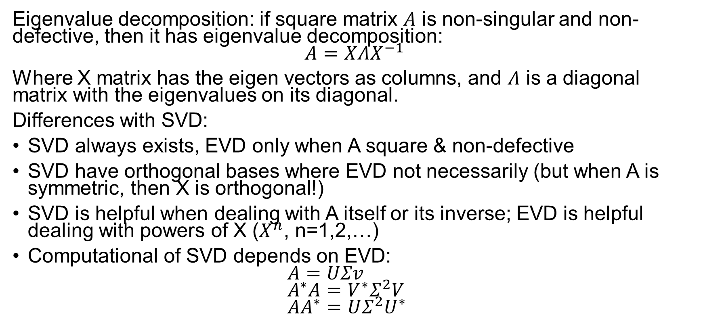
SVD vs. Eigenvalue Decomposition
Eigenvalue decomposition: if square matrix $A$ is non-singular and non-defective, then it has eigenvalue decomposition: $$A=XΛX^{−1}$$
Where X matrix has the eigen vectors as columns, and $Λ$ is a diagonal matrix with the eigenvalues on its diagonal.
Differences with SVD:
SVD always exists, EVD only when A square & non-defective
SVD have orthogonal bases where EVD not necessarily (but when A is symmetric, then X is orthogonal!)
SVD is helpful when dealing with A itself or its inverse; EVD is helpful dealing with powers of X ($X^{n}$, n=1,2,…)
Computational of SVD depends on EVD: $A=UΣv$ $A^{∗}A=V^{∗}Σ^{2}V$ $AA^{∗}=UΣ^{2}U^{∗}$

Slide 12
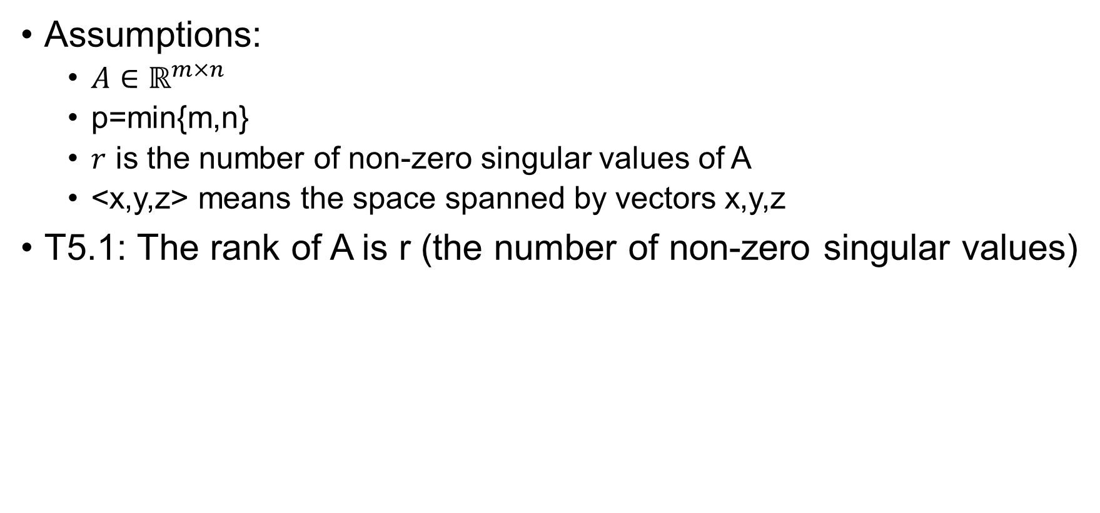
Matrix Properties via SVD
Assumptions:
$A∈ℝ^{m×n}$
p=min{m,n}
$r$ is the number of non-zero singular values of A
<x,y,z> means the space spanned by vectors x,y,z
T5.1: The rank of A is r (the number of non-zero singular values)

Slide 13
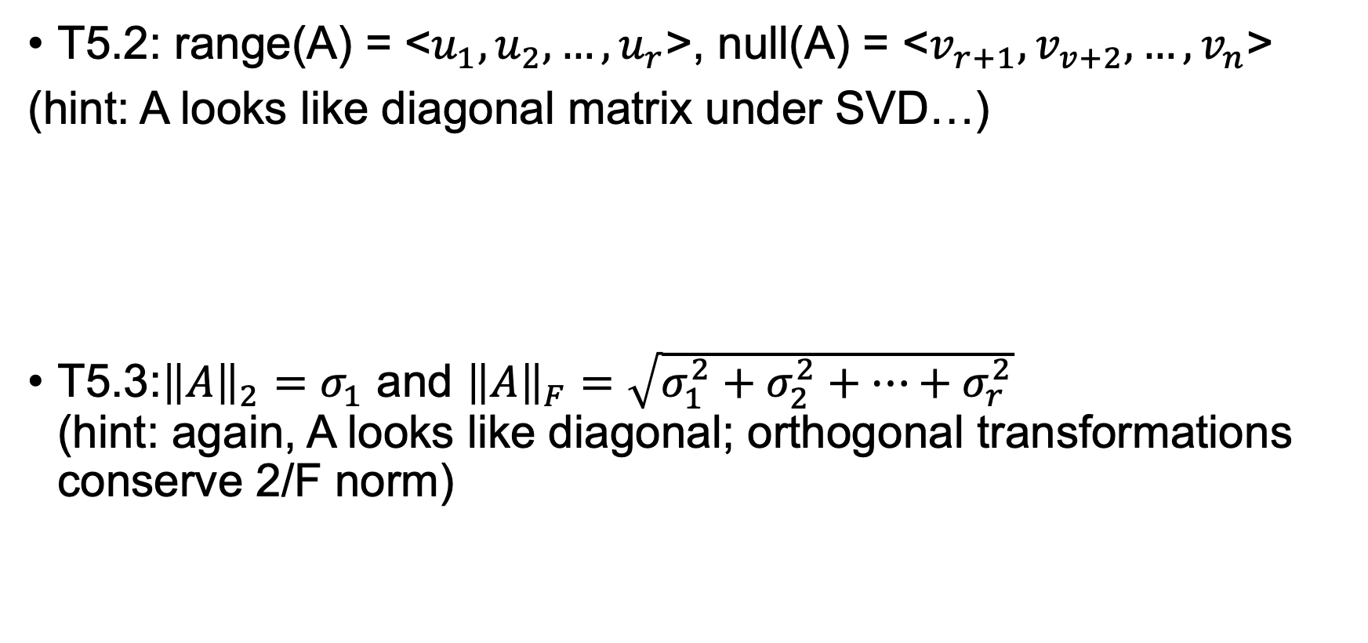
T5.2: range(A) = <$u_{1},u_{2},…,u_{r}$>, null(A) = <$v_{r+1},v_{v+2},…,v_{n}$>
(hint: A looks like diagonal matrix under SVD…)
T5.3:${\left\|A\right\|}_{2}=σ_{1}$ and ${\left\|A\right\|}_{F}=\sqrt{σ_{1}^{2}+σ_{2}^{2}+…+σ_{r}^{2}}$ (hint: again, A looks like diagonal; orthogonal transformations conserve 2/F norm)

Slide 14
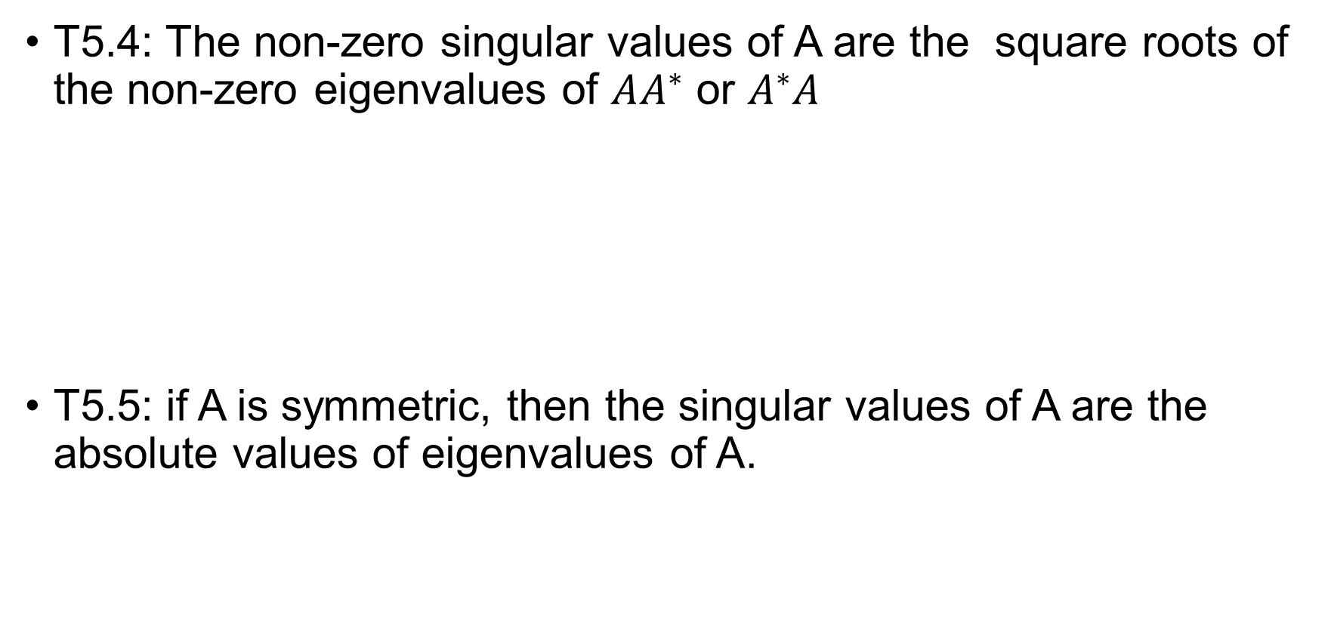
T5.4: The non-zero singular values of A are the square roots of the non-zero eigenvalues of $AA^{∗}$ or $A^{∗}A$
T5.5: if A is symmetric, then the singular values of A are the absolute values of eigenvalues of A.

Slide 15
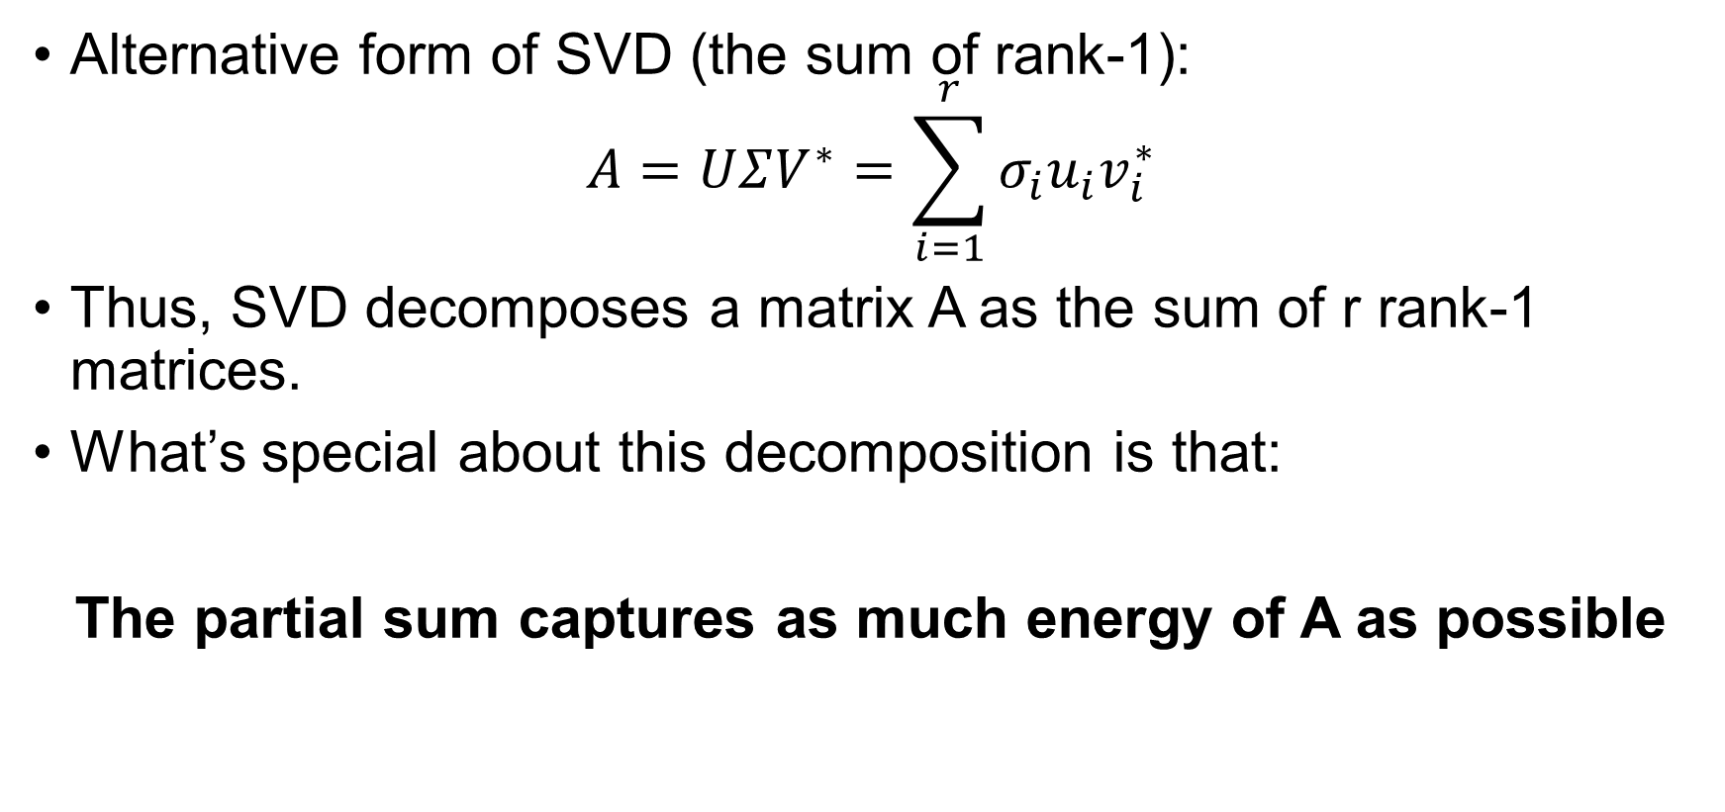
Low rank approximations
Alternative form of SVD (the sum of rank-1): $A=UΣV^{∗}=\sum_{i=1}^{r}{σ_{i}u_{i}v_{i}^{∗}}$
Thus, SVD decomposes a matrix A as the sum of r rank-1 matrices.
What’s special about this decomposition is that:
The partial sum captures as much energy of A as possible

Slide 16
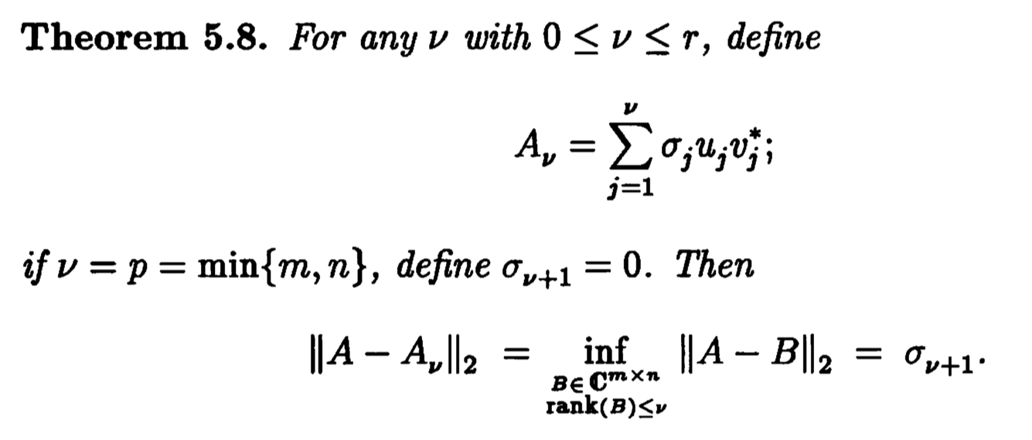
SVD gives optimal low-rank approximation

Slide 17
Example Application of SVD
Image compression. We have a 512x512 pixels Lena picture as a 512x512 matrix A

Slide 19
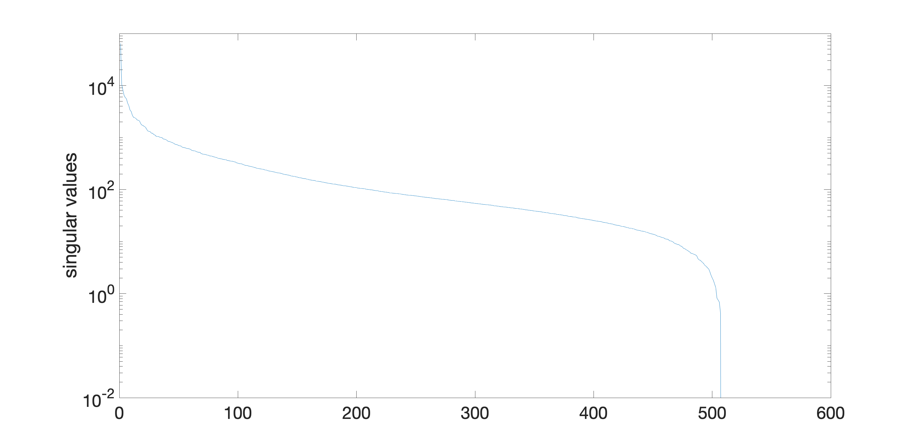

Slide 20
Applications in Data Science
Semantic Analysis
Collaborative filtering/recommendation (Netflix Prize!)
Pseudo-inverse (used for least square problem)
Data compression
Principal component analysis
…

